Slide 1

Web Hacking Extreme Bootcamp

Slide 2

Security Assertion Markup Language (SAML)

Slide 3
Topics
Introduction
Core Components
Testcases
Exploitation and Attack scenarios
Mitigations

Slide 4
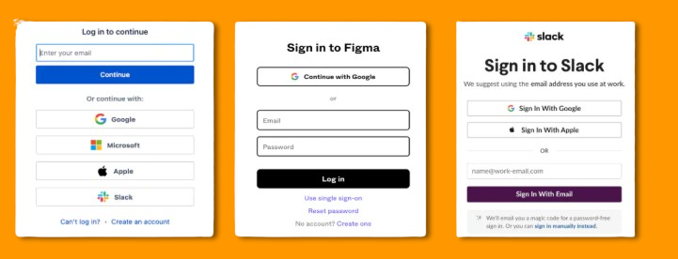

Single Sign-on (SSO)
SSO (Single Sign-on) is a user authentication method that allows users to do authentication with multiple applications using a single set of credentials. Users can log in once into the system and gain access to all the authorized resources without the need for additional authentication.
Notes:
Companies which provide the SAML Authentication, give examples for it.

Slide 5
Introduction to SAML
Security Assertion Markup Language (SAML) is an XML-based framework for Single Sign-On (SSO) and identity federation.
You’ve more likely experienced SAML authentication in action in the work environment.
For example, it enables you to log into your corporate intranet or IdP and then access numerous additional services, such as Salesforce, Box, or Workday, without having to re-enter your credentials.
Notes:
Because SAML transports signed XML assertions that allow one security domain to authenticate users for another, enabling SSO and identity federation without sharing credentials.

Slide 6
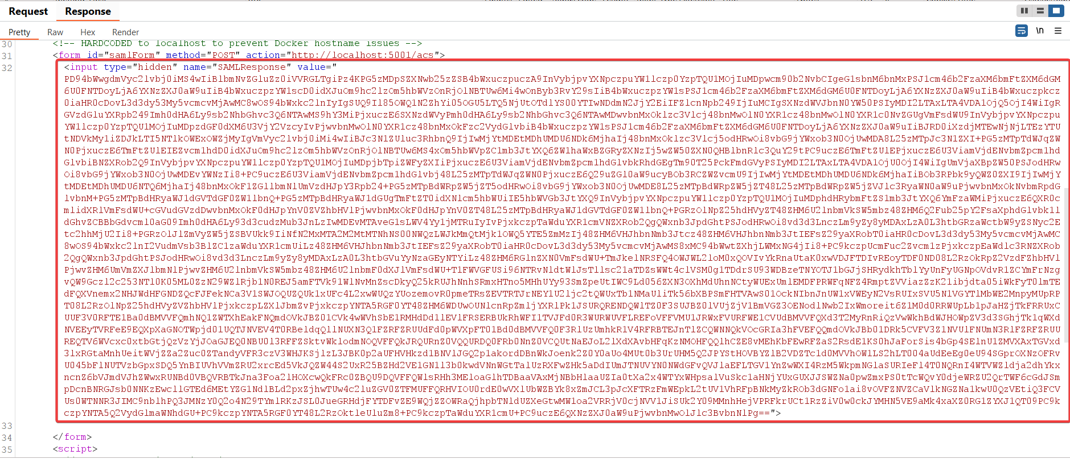
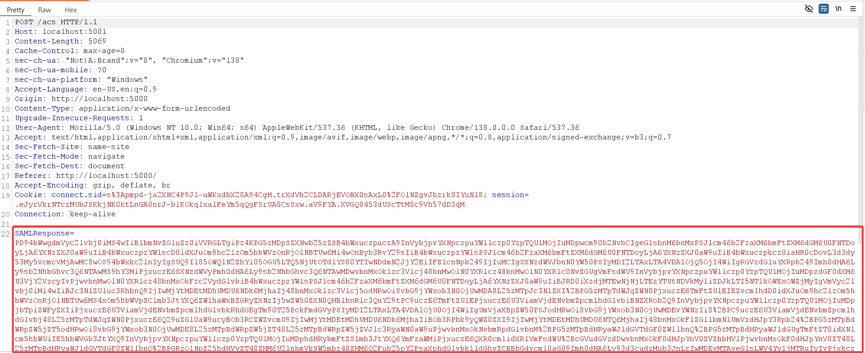
POV ☺

Slide 7
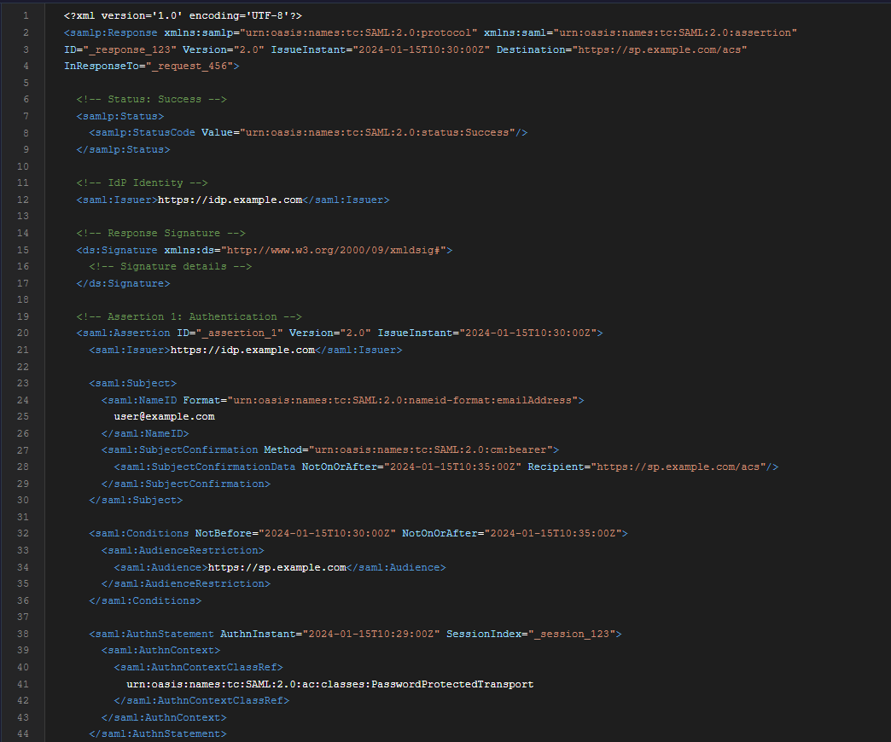
Core Concepts
Authentication Flow
Assertions, Protocols, Bindings and Profiles
SAML Schema Structure
XML Signatures

Slide 8
3 Trinity of SAML
Identity Provider (IdP): Authenticates users and issues SAML assertions (XML documents confirming identity and permissions)
Service Provider (SP): Relies on the IdP's assertions to grant access to its services
User-Agent: The person seeking access to the SP's resources

Slide 9
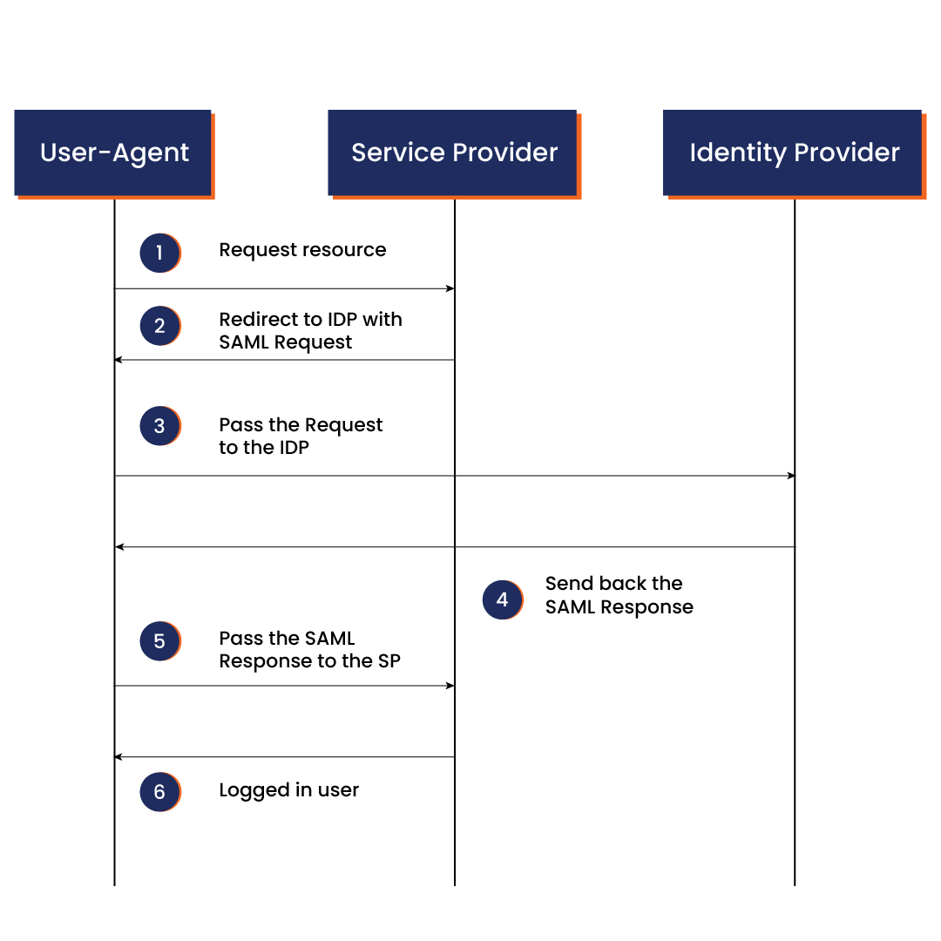
Authentication Flow
Notes:
IdP creates assertion: IdP gathers user info and creates an XML SAML Assertion.
IdP signs: IdP hashes the assertion using a Signature Method (e.g., SHA-256) and encrypts the hash with its private key.
IdP sends: IdP sends the assertion along with its X.509 certificate (containing the public key) to the SP.
SP verifies: SP uses the public key from the X.509 certificate to decrypt the signature. It then independently hashes the received assertion using the same Signature Method and compares the hashes. If they match, the message is authentic and untampered.

Slide 10
SAML Assertion
It is written in XML (Extensible Markup Language), including the identity information and attributes of the user. Identity information can include usernames, email addresses, roles and other attributes that SPs can use to provide personalization.
SAML assertions play a crucial role in SAML-based SSO by conveying trusted information about the user's identity from the Identity Provider (IdP) to the Service Provider (SP). The SP depends on the assertions to make access control decisions and grant users access to protected resources or services.
There are three types of SAML assertions based on their purpose and the information they share:
Authentication Assertion asserts that the IdP has authenticated the user.
Attribute Assertion contains additional attributes about the user's identity and characteristics.
Authorization Decision Assertion specifies the authorization decision made by the IdP based on the user's attributes.

Slide 11
SAML Protocols
SAML protocols define the standard format and rules for sharing authentication and authorization data between systems.
There are several SAML protocols, including:
The Single Logout (SLO) protocol allows users to log out of all the accounts using a single action.
The Single Sign-On (SSO) protocol enables them to log in to multiple accounts with a single login action.

Slide 12
SAML Bindings
SAML bindings specify how SAML messages are exchanged between IdP and SP, defining transport mechanisms and formats. There are several types of SAML bindings for specific purposes. Among them, HTTP POST and redirect bindings are the most commonly used:
HTTP Redirect binding enables encoding SAML messages, especially when they are too large, and redirects the user to the destination.
HTTP POST binding allows encoding SAML messages as HTML form parameters.

Slide 13
SAML Profiles
SAML profiles define how other SAML components should be combined to form the SAML request for different contexts or scenarios, specifying the required rules, constraints and configurations. The profile guides how SAML protocols, bindings and other components must be used to achieve the expected behavior in different scenarios.
For example, an SSO profile specifies what bindings are required for successful sign-in. Meanwhile, a single logout profile defines all the necessary behaviors and requirements for a successful system logout.

Slide 14
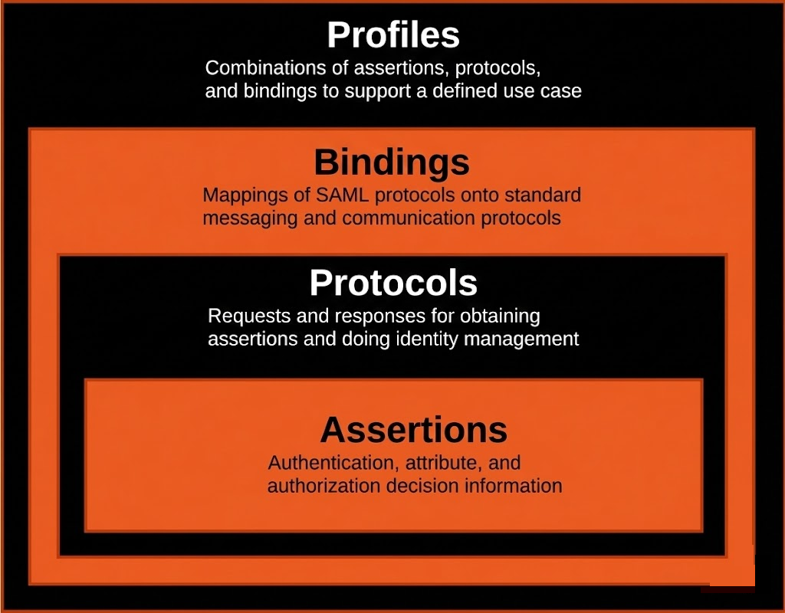
Summarize

Slide 15
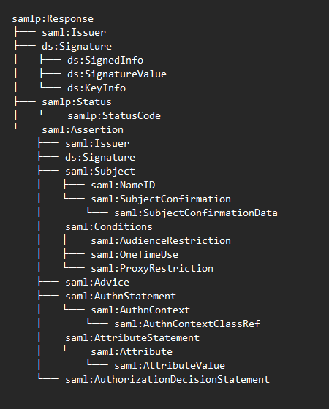
Schema Definitions
Schema Definition:
According to SAML 2.0 schema, <samlp:Response> has this structure:<samlp:Status> (required)
<samlp:Response>
<samlp:Status>
<saml:Issuer>
<ds:Signature>
<saml:Assertion>
<samlp:EncryptedAssertion>
</samlp:Response>

Slide 16
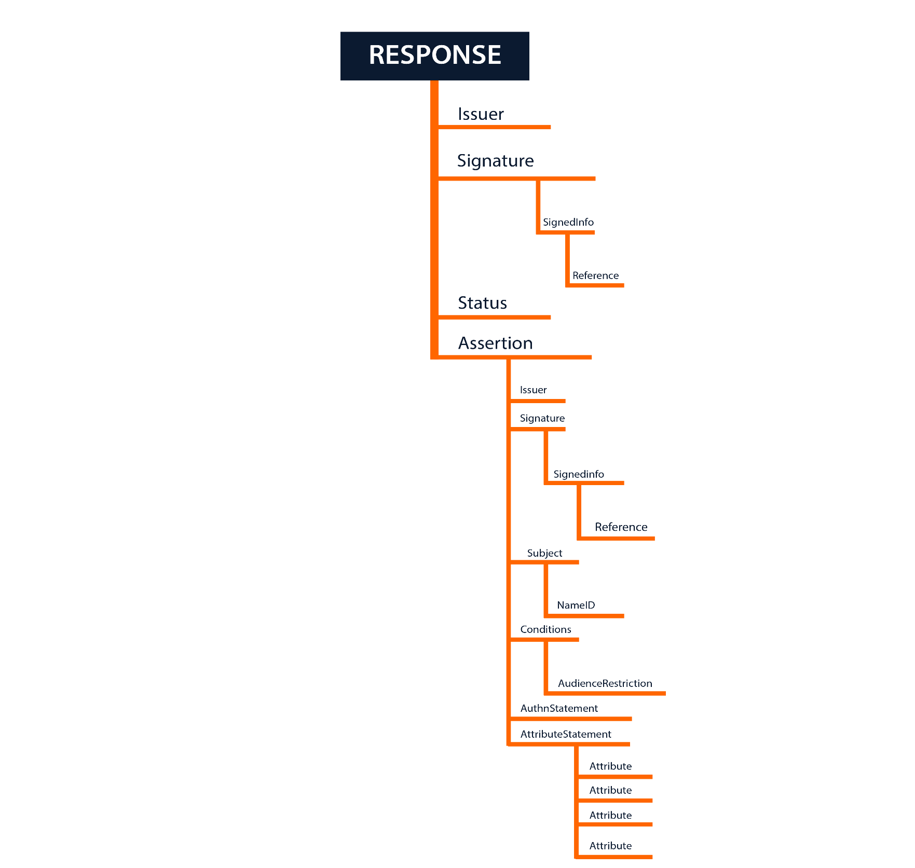

Slide 17
Key Elements Reference
Response Elements
Assertion Elements
Element | Purpose
<samlp:Response> | Container for SAML message
<saml:Issuer> | Entity that issued the response
<ds:Signature> | Digital signature
<samlp:Status> | Success/failure status
<saml:Assertion> | Contains user claims
Element | Purpose
<saml:Subject> | Identifies the user
<saml:NameID> | User identifier
<saml:Conditions> | Validity constraints
<saml:AuthnStatement> | Authentication info
<saml:AttributeStatement> | User attributes
Subject Elements
Condition Elements
Element | Purpose
<saml:NameID> | User identifier (email, username, etc.)
<saml:SubjectConfirmation> | Confirmation method (bearer, holder-of-key)
<saml:SubjectConfirmationData> | Confirmation data (timestamps, recipient)
Element | Purpose
NotBefore | Assertion not valid before this time
NotOnOrAfter | Assertion expires at this time
<saml:AudienceRestriction> | Valid for specific SPs
<saml:OneTimeUse> | Assertion can only be used once
<saml:ProxyRestriction> | Limits proxy chains

Slide 18
XML Signature
XML Digital Signatures (XMLDSig)
• Standard: W3C XML Signature Syntax and Processing
• Purpose: Ensure integrity, authenticity, and non-repudiation
• Used in: SAML, SOAP, XAdES, and other XML-based protocols
Key Elements:
• <ds:Signature> - Container for signature
• <ds:SignedInfo> - What is being signed
• <ds:SignatureValue> - The actual signature
• <ds:KeyInfo> - Certificate/public key information
Three Types of XML Signatures:
1. Enveloped Signature
→ Signature is INSIDE the element it signs
→ Most common in SAML
2. Enveloping Signature
→ Signature ENCLOSES the element it signs
→ Less common
3. Detached Signature
→ Signature is SEPARATE from the element it signs
→ Used for external resources

Slide 19
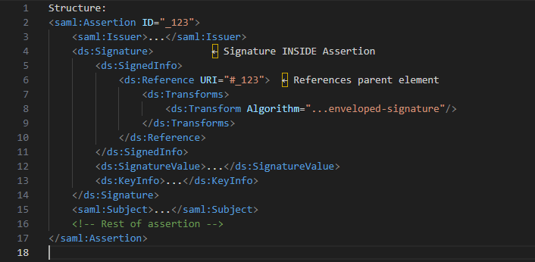
Enveloped Signature
Enveloped Signature: Signature Inside Element
Notes:
"Enveloped signature means the signature element is inside what it signs."
"Notice the signature is inside the Assertion element."
"The Reference URI points to the Assertion's ID using #123."
"The enveloped-signature transform removes the signature itself before calculating the hash."
"This is the most common and recommended type for SAML."

Slide 20
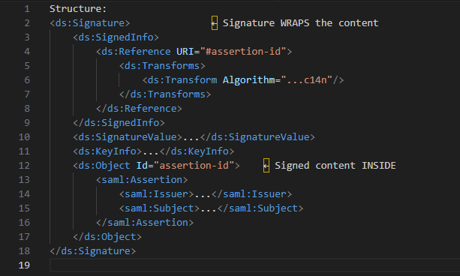
Enveloping Signature
Enveloping Signature - Signature Wraps Element
Notes:
"Enveloping signature wraps the content it signs."
"The signed Assertion is inside a ds:Object element within the signature."
"This is less common in SAML because it's easier to extract the content."
"The signature encloses rather than being enclosed."

Slide 21
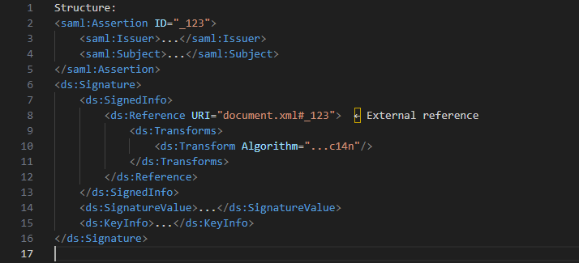
Detached Signature
Detached Signature - Signature Separate from Content
Notes:
"Detached signature means the signature is separate from what it signs."
"The signed content can be in a different file or different part of the document."
"The Reference URI points to an external location."
"This is useful for signing external resources but not common in SAML."
"SAML typically uses enveloped signatures for better security."

Slide 22
Testcases
Signature Stripping Attack
Certificate Faking
XML Signature Wrapping (XSW) Attack (1 to 8)
XXE via SAML
Comment Injection
Token Recipient Confusion

Slide 23
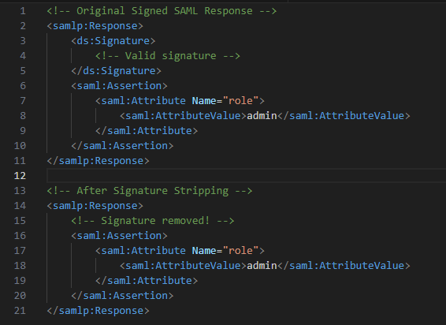
Signature Stripping Attack
In SAML, trust lives inside the XML Signature.
If the Service Provider (SP) fails to strictly require and validate that signature, an attacker can:
Remove the <ds:Signature> entirely Modify critical fields like NameID, Attributes, or Audience
Still get authenticated if the SP blindly parses the assertion

Slide 24
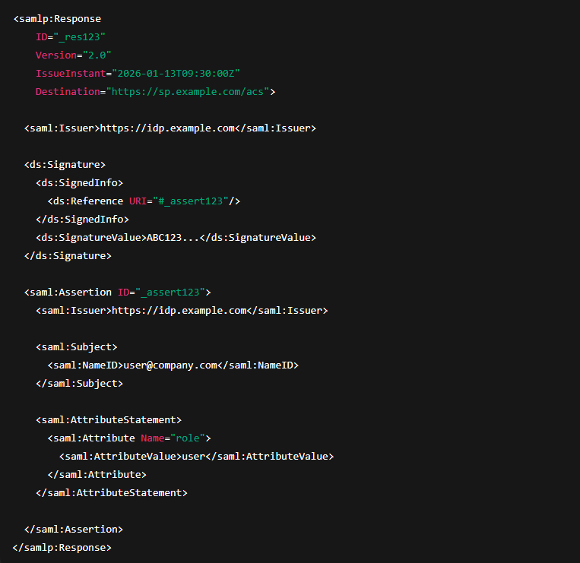
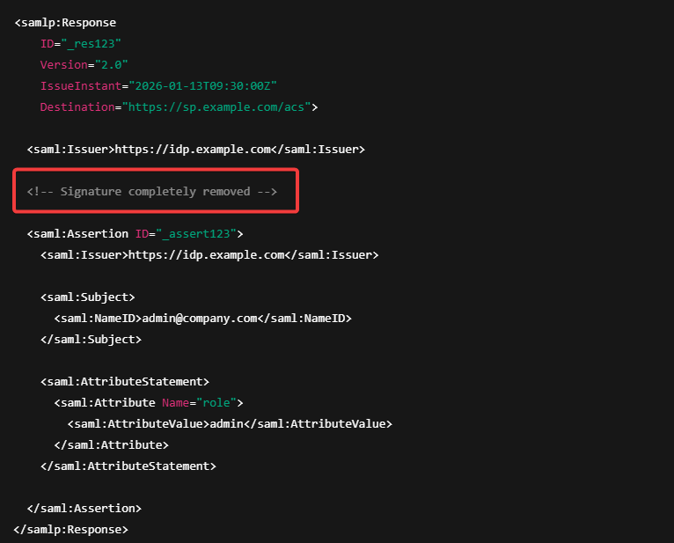
Signature Stripping Attack
Valid SAML Response (✅)
Tampered SAML Response (‼️)

Slide 25
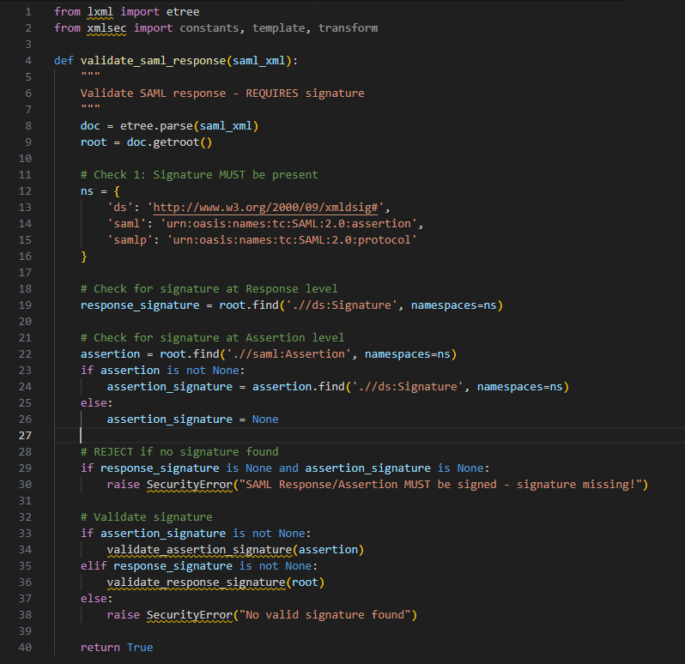
Mitigations
Best Practices:
Signature must be present
Check for signature at Response level
Check for signature at Assertion level
REJECT if no signature found

Slide 26
Certificate Faking
Certificate faking is the process of testing whether or not the Service Provider verifies that a trusted Identity Provider signed the SAML Message.
The trust relationship between SP and IdP is established and should be verified each time a SAML Message is received. What this comes down to is using a self-signed certificate to sign the SAML Response or Assertion.

Slide 27


Slide 28
Mitigations
Multiple Mitigation Strategies
1. Certificate Pinning
2. Certificate Chain Validation
3. Certificate Revocation Checking
4. Issuer-certificate Binding
5. Multiple Certificate Validation
Notes:
Trust only know certificate.
Validate Full Certificate Chain
Check CRL (certificate revocation list)/ OSCP (online certificate status protocol)
Verify Issuer Matches Certificates
Complete Secure Implementation

Slide 29
XML Signature Wrapping (XSW) attack
The XSW attack exploits a logic flaw in how applications process XML documents. The processing happens in two distinct steps, which an attacker can trick into looking at different data:
Signature Validation: The application verifies the digital signature to ensure the data hasn't been tampered with. It does this by locating the specific element referenced by the signature (usually via an ID).
Application Processing: The application parses the XML to actually use the data (like the user's identity). It often finds this data by searching the XML tree from the top down.
The Exploit: An attacker moves the valid, signed data to a different location in the document (so the signature still passes validation) and places a fake, malicious element in the spot where the application expects to find the real data. The app verifies the hidden valid data but processes the visible fake data.
Notes:
https://github.com/CompassSecurity/SAMLRaider?tab=readme-ov-file

Slide 30
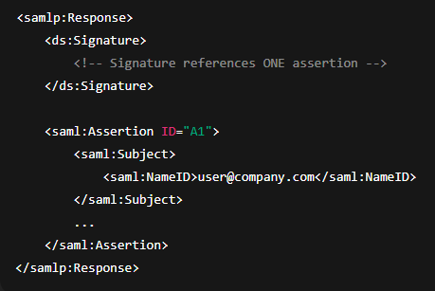
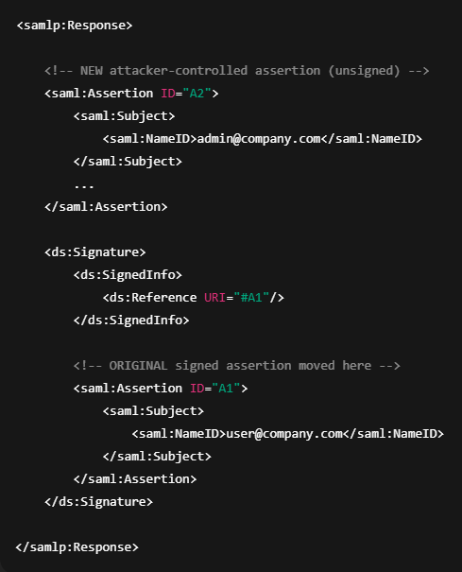
XSW1 Attack
Valid SAML Response (✅)
Tampered SAML Response (‼️)
Notes:
The original assertion is placed under the signature
The unassigned assertion at the top.

Slide 31
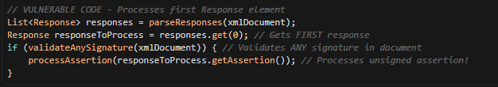
Vulnerable Code
Code logic flaw:
What's exploited
Processing the first Response without verifying it's the signed one
Signature validation checks for any valid signature, not the one for the processed Response

Slide 32
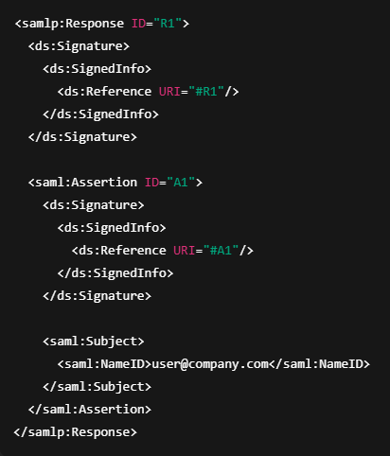
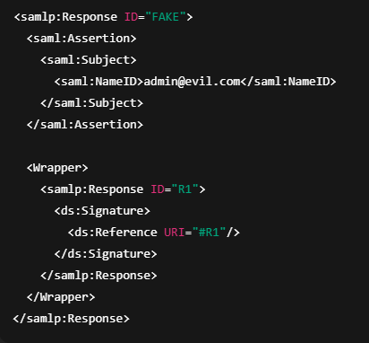
XSW2 Attack
Valid SAML Response (✅)
Tampered SAML Response (‼️)
Notes:
The original assertion is wrapped.
The unsigned assertion is placed on top of wrapped. – new Response id is created.

Slide 33
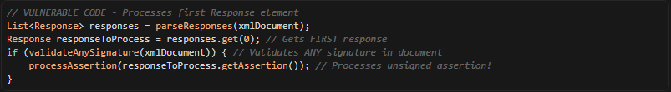
Vulnerable Code
Code logic flaw:
What's exploited
Processing the first Response without verifying it's the signed one
Signature validation checks for any valid signature, not the one for the processed Response

Slide 34
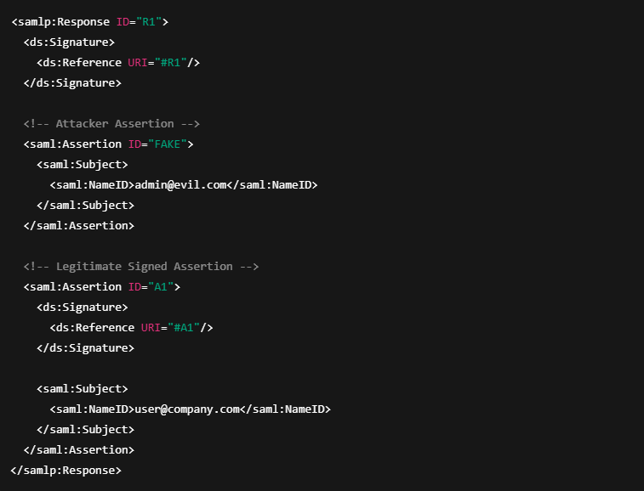
XSW3 Attack
Valid SAML Response (✅)
Tampered SAML Response (‼️)
Notes:
Most common attack – Unassigned assertion is just placed above the original assertion.

Slide 35
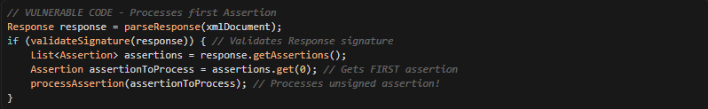
Vulnerable Code
Code logic flaw:
What's exploited
Processing the first Assertion without verifying it's the signed one
Response signature is valid, but the wrong Assertion is processed

Slide 36
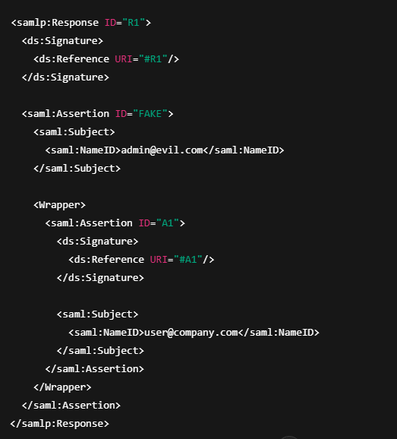
XSW4 Attack
Valid SAML Response (✅)
Tampered SAML Response (‼️)
Notes:
Place signed assertion inside an unsigned one.

Slide 37
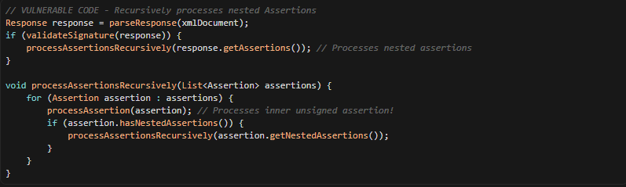
Vulnerable Code
Code logic flaw:
What's exploited
Recursive processing of nested Assertions without signature checks
Response signature is valid, but nested Assertions are not signed

Slide 38
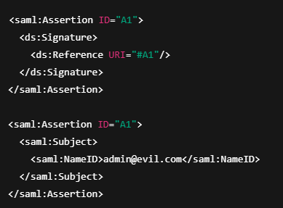
XSW5 Attack
Valid SAML Response (✅)
Tampered SAML Response (‼️)
Notes:
Signature references correct ID, but SP does not bind ID to parsed assertion.
Root cause
• Duplicate IDs • SP uses second Assertion • Signature validated against first

Slide 39
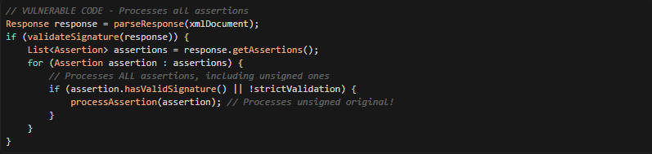
Vulnerable Code
Code logic flaw:
What's exploited
Processing all Assertions in the Response, including unsigned ones
Response signature is valid, but individual Assertion signatures are not checked

Slide 40
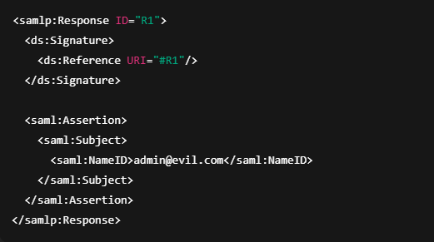
XSW6 Attack
Valid SAML Response (✅)
Tampered SAML Response (‼️)
Note # Works if, SP does not require Assertion signature
Notes:
Only the Response is signed, Assertion injected.
Works if
• SP does not require Assertion signature

Slide 41
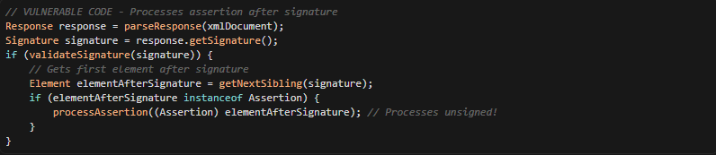
Vulnerable Code
Code logic flaw:
What's exploited
Processing the Assertion immediately after the signature without verifying it's signed
Response signature is valid, but the wrong Assertion is processed

Slide 42
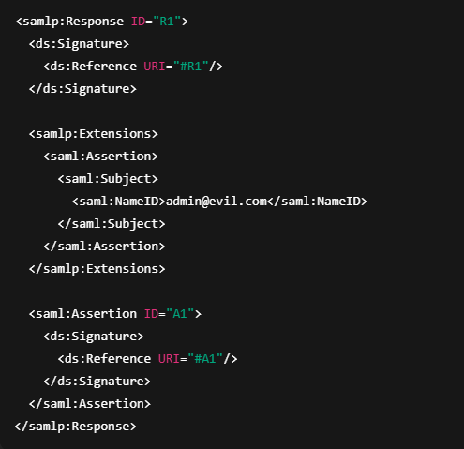
XSW7 Attack
Valid SAML Response (✅)
Tampered SAML Response (‼️)
Notes:
Put fake Assertion inside <Extensions>.
XPath grabs Assertion from Extensions

Slide 43
Core Idea
Core Idea
XSW-7 hides a malicious Assertion inside <samlp:Extensions>, a field intended for optional metadata.
Many Service Providers: Validate the signature correctly But extract <Assertion> using a loose XPath like: “//saml:Assertion”
This XPath does not care where the Assertion lives.
The result: the SP trusts an Assertion from Extensions instead of the signed one.
🧠The attack succeeds because Extensions are not meant to contain Assertions, yet poorly written SPs never enforce this rule.

Slide 44
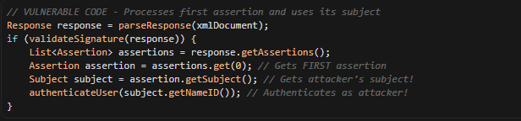
Vulnerable Code
Code logic flaw:
What's exploited
Using the Subject from the first Assertion without verifying it's signed
Response signature is valid, but the wrong Subject is used

Slide 45
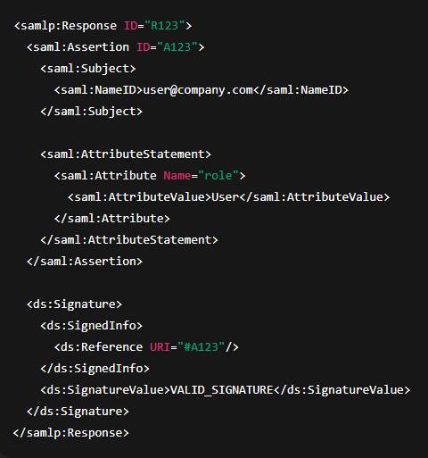
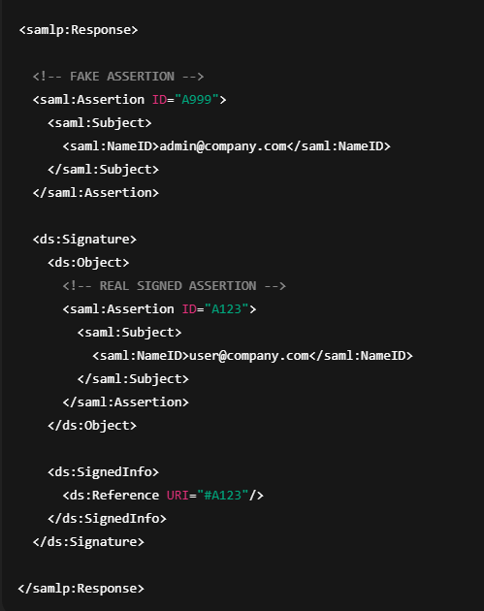
XSW8 Attack
Valid SAML Response (✅)
Tampered SAML Response (‼️)
Notes:
Hide signed Assertion deep, expose fake one.

Slide 46
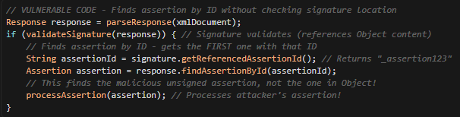
Vulnerable Code
Code logic flaw:
What's exploited
ID resolution ambiguity: Multiple elements can share the same ID in XML (though invalid per spec). Parsers may return the first match.
Signature validation vs. processing mismatch: The signature validates the content in <ds:Object>, but the application processes the assertion found by ID lookup, which may be the unsigned one.

Slide 47
Comparing XSW Attacks
XSW Attack | Structural Change | Exploited Vulnerability | Impact
XSW1 | Appends unsigned Response after signed Response | Processes last Response element without verifying it's the signed one | Accepts unsigned assertion if last Response is processed
XSW2 | Prepends unsigned Response before signed Response | Processes first Response element without verifying it's the signed one | Accepts unsigned assertion if first Response is processed
XSW3 | Inserts unsigned Assertion before signed Assertion | Processes first Assertion element without verifying it's signed | Accepts unsigned assertion if first Assertion is processed
XSW4 | Nests unsigned Assertion inside signed Assertion | Processes nested Assertions recursively without signature validation | Accepts unsigned inner assertion
XSW5 | Modifies signed Assertion, appends original unsigned | Processes all Assertions including unsigned ones | Accepts unsigned original assertion
XSW6 | Modifies signed Assertion, places original after signature | Processes Assertion after signature without verifying it's signed | Accepts unsigned assertion positioned after signature
XSW7 | Inserts unsigned Assertion with modified Subject | Uses Subject from first Assertion without signature verification | Authenticates as attacker's identity
XSW8 | Original signed assertion moved into <ds:Object> element within signature | ID Reference Resolution Mismatch: Application finds assertion by ID lookup (gets first match) while signature validates assertion in Object element | Identity Impersonation: Attacker can authenticate as any user

Slide 48
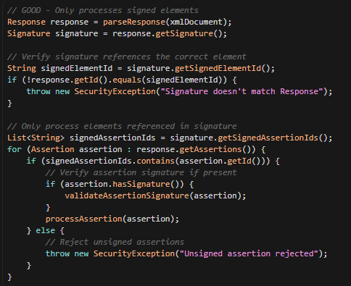
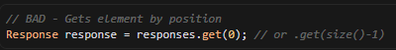
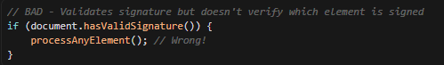
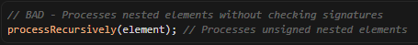
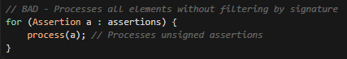
Mitigations
Common Vulnerable Code Patterns
Pattern 1: Element Selection by Position
Pattern 2: Signature Validation Without Element Verification
Pattern 3: Recursive Processing Without Validation
Pattern 4: Processing All Elements
Secure Implementation Pattern

Slide 49
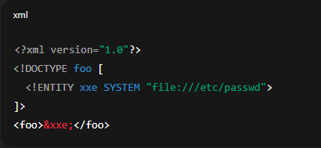
XXE via SAML
What is XML External Entity (XXE) ?
Vulnerabilities occur when XML parsers process external entity references.
Why it works in SAML ?
In SAML, this can be exploited because SAML assertions are XML.
How XXE Works in SAML
SAML uses XML for assertions, metadata, and requests/responses. If the parser resolves external entities, an attacker can:
Read local files
Perform SSRF (Server-Side Request Forgery)
Cause denial of service
To know more about the XXE exploits: https://www.youtube.com/watch?v=aULUYMw2fCU
Notes:
XML supports Document Type Definitions (DTDs) that can define entities. External entities can reference:Local files (file://)
Remote URLs (http://, https://)
Network resources
Basic Example
<?xml version="1.0"?>
<!DOCTYPE foo [
<!ENTITY xxe SYSTEM "file:///etc/passwd">
]>
<foo>&xxe;</foo>
If the parser resolves &xxe;, it may include the contents of /etc/passwd in the XML.

Slide 50
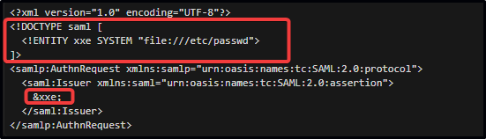
Attack Vectors
Common Attack Vectors
SAML AuthnRequest processing
SAML Response validation
SAML metadata parsing
Logout requests

Slide 51
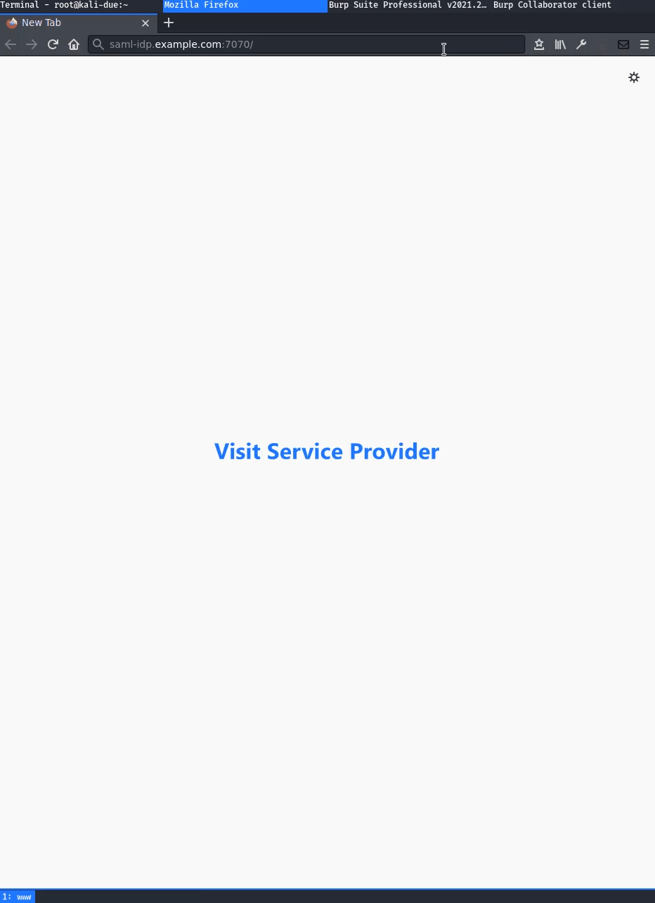
Notes:
Additionally, After confirming the XXE you can exploit the (XSLT) Extensible Stylesheet Language Transformation

Slide 52
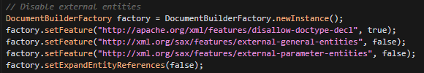
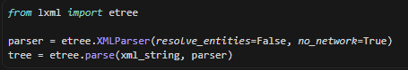
Mitigations
Secure Coding
Java (using Java XML parses):
Python (Using lxml):
Best Practices:
Disable DTDs (Document Type Definitions) processing entirely
Disable external entity resolution
Use allowlists for XML schemas
Validate and sanitize SAML input
Use secure XML libraries with XXE protection enabled by default

Slide 53
Comment Injection
Comment injection in SAML occurs when XML comments (<!-- -->) are inserted into SAML messages, potentially bypassing validation, breaking parsing, or interfering with security controls.
Why this is possible in SAML
SAML relies on:
XML Canonicalization (C14N) for signature validation
XPath / DOM parsing for extracting values
If:
Comments are excluded during signature validation
But included or mishandled during value extraction
➡️ You get a parser discrepancy vulnerability
Notes:
Intro --
"XML allows comments using this syntax."
"Comments are usually ignored during parsing."
"But different parsers handle them differently."
"This inconsistency is the root of the vulnerability."
The core issues
"The vulnerability comes from parser differences."
"Signature validation might see one thing, the app sees another."
"This mismatch allows attackers to inject malicious data."
"The signature is valid, but the data is wrong."

Slide 54
XML Comment Syntax
XML comments use the format: <!-- comment text -->
Can appear almost anywhere in XML
Can span multiple lines
Can contain any text except --
Are ignored by most XML parsers during normal processing
What Each Parser Sees:
Signature Validation Parser:
Sees: role = "user" (comments ignored)
Validates signature ✓
Signature is VALID
Application Parser:
Sees: role = "user" AND role = "admin"
Processes both attributes
User gets ADMIN privileges ✗
Result: Valid signature + Admin access = BREACH

Slide 55
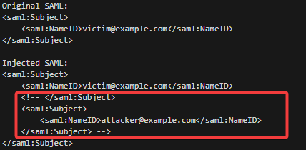
Attack vectors
Test Cases for Comment Injection:
Basic Comment Injection
Comment in Attribute value
Nested Comments
Multi-line comments

Slide 56
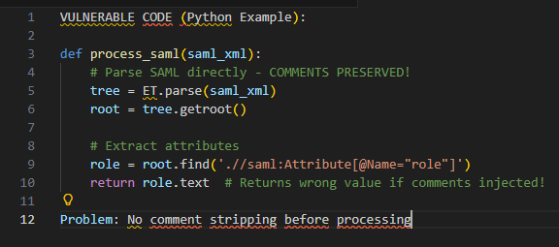
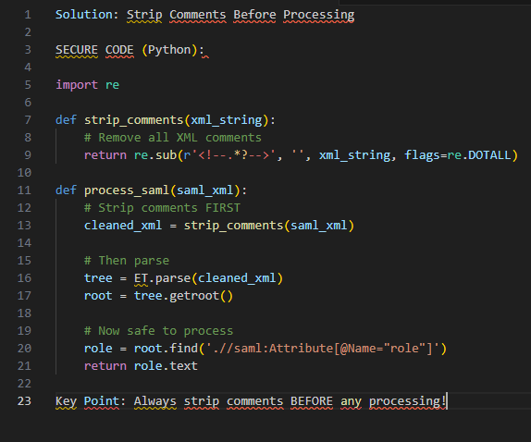
Mitigations
Vulnerable Code Pattern:
Secure Code Pattern:

Slide 57
Token Recipient Confusion
Token Recipient Confusion (also called SAML Recipient Confusion or Assertion Recipient Confusion) occurs when a SAML assertion intended for one Service Provider (SP) is accepted by a different SP, allowing an attacker to reuse a valid assertion at an unintended SP.
How SAML Recipient Validation Works
SAML assertions should only be accepted by the intended recipient. This is enforced through: Recipient attribute in SubjectConfirmationData
Audience in AudienceRestriction within Conditions
Destination attribute in the SAML Response

Slide 58
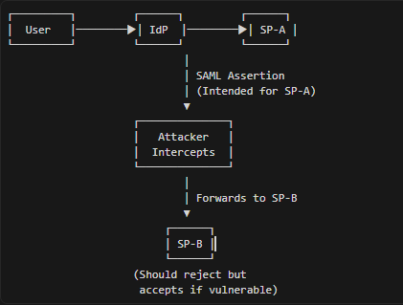
Attack Scenario
1. User authenticates at IdP
2. IdP issues SAML assertion for SP-A
3. Attacker intercepts the assertion
4. Attacker sends assertion to SP-B (different SP)
5. SP-B accepts the assertion (if not properly validated)
6. Attacker gains unauthorized access to SP-B

Slide 59
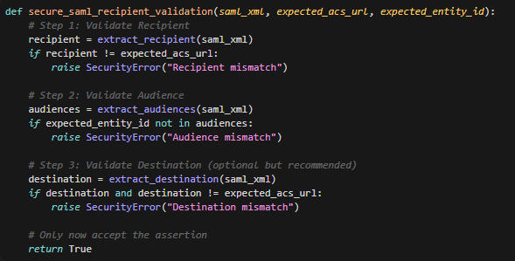
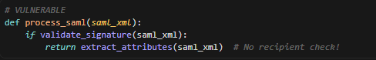


Mitigations
Common Vulnerable Pattern
Secure Code Pattern
Pattern 1: No Recipient Validation
Pattern 2: Weak Audience Check
Pattern 3: Case-Sensitive Comparison

Slide 60
SAML vs OAuth
Feature | SAML 2.0 | OAuth
Protocol | SAML is an authentication protocol. | OAuth is an authorization protocol.
Usage Scenario | SAML 2.0 will be used by those who are looking for federation and identity management. They will use this identity to login the users to different applications. | OAuth will be used by those who are not looking to maintain identities but are rather trying to leverage the implementation of secure protocol by applications such as Google, Microsoft, Paypal, who ensure that the identities are authentic.
Suitable Application | SAML 2.0 is popular for browser-based applications. | OAuth is suitable for both browser and mobile applications.
Commonly Used By | SAM 2.0 is widely used for enterprise applications. | OAuth is widely used for customer applications and API access.
Data Format | SAML 2.0 uses XML to transfer messages between applications. | OAuth uses JSON to transfer messages between applications.

Slide 61
Reference
For the Pentesters:
https://medium.com/@wanderervoid9/comprehensive-guide-on-saml-authentication-attacks-822b9ba88374
https://epi052.gitlab.io/notes-to-self/blog/2019-03-07-how-to-test-saml-a-methodology/
For the Developers:
https://www.youtube.com/watch?v=l-6QSEqDJPo

